Slide 1




IE Sustainability Datathon 2023
IE- SCHOOL OF SCIENCE & TECHNOLOGY
27.10.2023

Slide 2
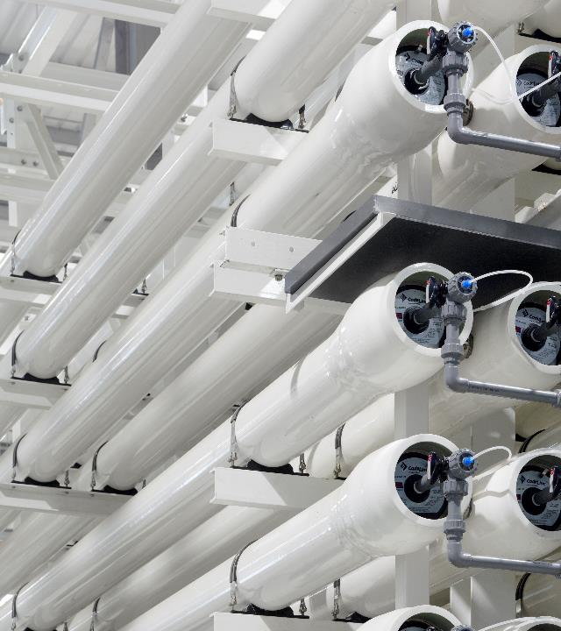
Acciona
Spanish multinational conglomerate
Dedicated to the development and management of infrastructure
Water Solutions
In more than 40 countries
Notes:
Spanish multinational conglomerate
Dedicated to the development and management of infrastructure (construction, water, industrial and services) & renewable energy
Water Solutions (end-to-end water management, drinking water treatment, waste water treatment, desalination, water services for cities, water reuse)
Experience in more than 40 countries

Slide 3
Challenge
Develop a predictive model to estimate water consumption by sector in the city of Villarrubia for the ensuing 7-day period
To achive the following key outcomes:
Ensure consistent and reliable water service provision
Preventing disruptions and anticipating potential anomalies
Optimize resource allocation
Minimization environmental impact
Equitable access to water

Slide 4


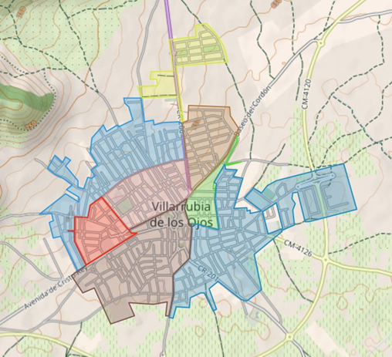
Data Provided
Datasets
Villarrubia
Villarrubia de los Ojos, Spain, province of Ciudad Real, Castilla–La Mancha
Population 9.667
Total area of 281,86 km²
Acciona - Contract since 2014
Caudales: Water consumption
Gis: Hierarchical & locational water supply grid
Abonado: Provision of service
Cliente: Customer information
Contador: Meter and its manufacturer
Clima: weather conditions
(Time Period- August 2018 to December 2022)
8 Sectors

Slide 5
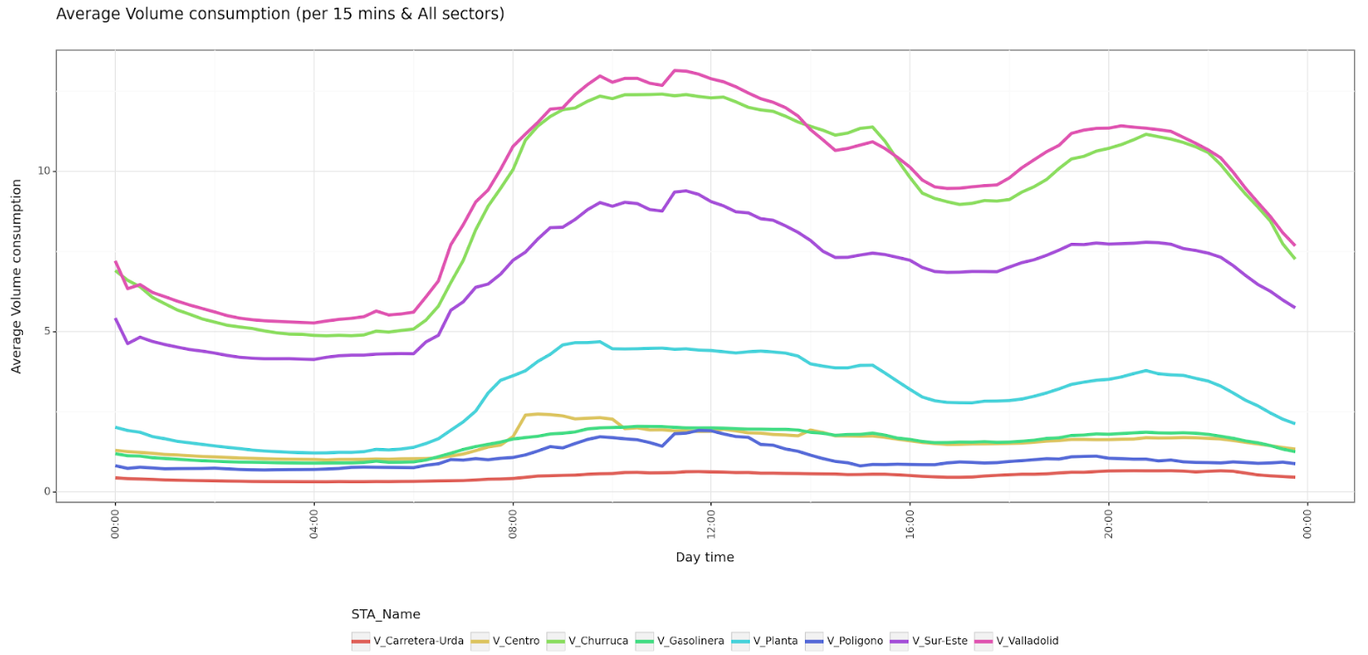
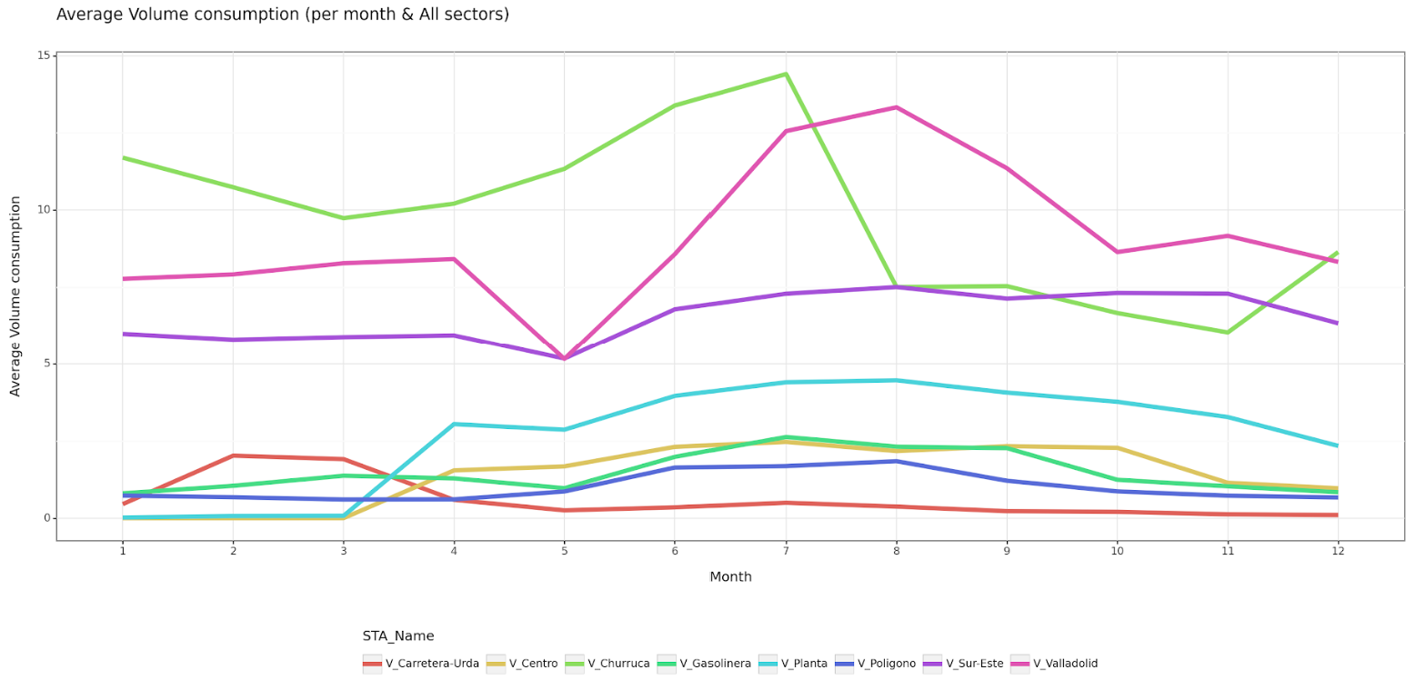
Solution – Insights
We uncovered valuable insights from the data:
Average Water Volume Consumption (per 15 min & all sectors)
Average Water Volume Consumption (per month & all sectors)
Villadolid Sector has the highest average water consumption
Peak consumption hours occur between 7:00h to 16:00h
Substantial variations between months
As expected, peak periods in summer months
Unexpected peak for Carretera-Urda in Feb/Mar

Slide 6
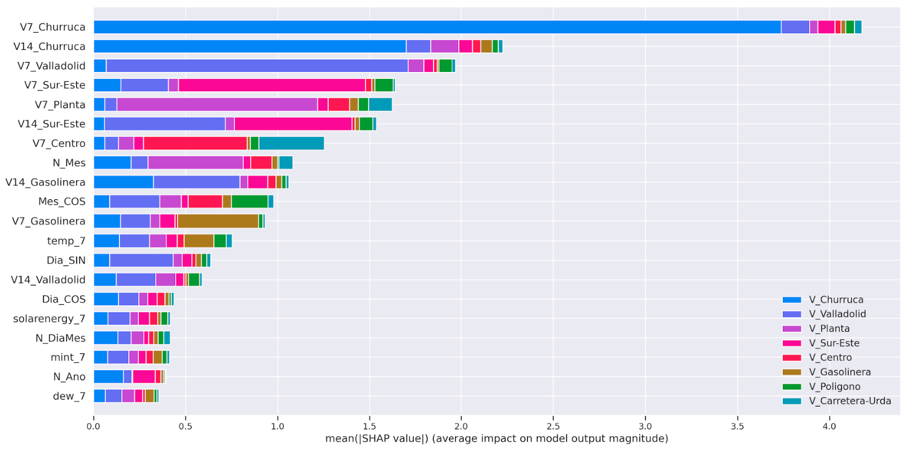

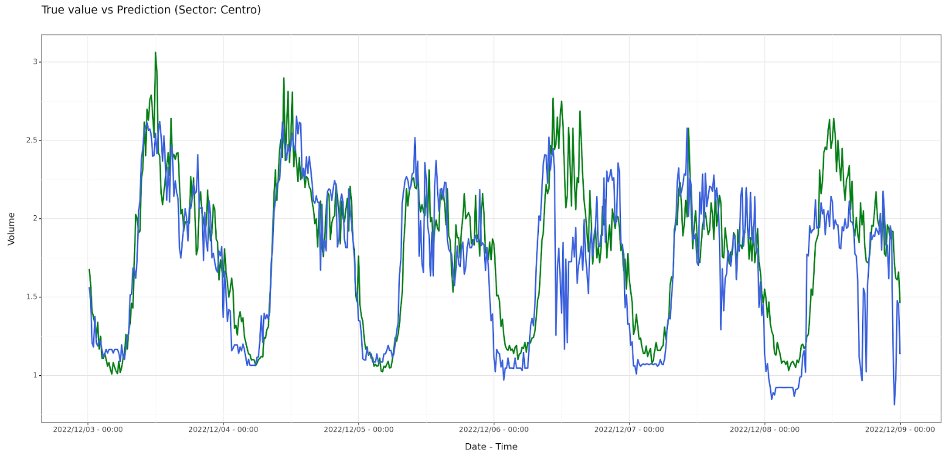
Solution – Model
Features Importance
Caudales
Weather
Workday
XGBOOST
(8 sectors)
True Value vs. Prediction
(Sector: Centro)

Slide 7

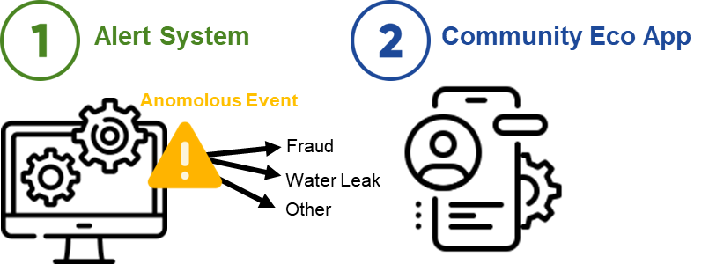

Solution – Prevention Plan
Alert System
Anomalous Event Detection:
Identifies sudden usage spikes, irregular patterns, based on historical data
Key Benefit: detection of anomalous situation as fraud
Water Leak Detection:
Uses flow rate changes to spot leaks
Establish a cloud-based data management warehouse to enable real-time anomaly detection with the trained model
Action Plan for Alert System
1. Thresholds for Alert Triggers
2. Proactive Maintenance
Notes:
Anomalous Event Detection:
Identifies sudden usage spikes, irregular patterns, based on historical data
Key Benefit: detection of anomalous situation as fraud
Water Leak Detection:
Uses flow rate changes to spot leaks
Establish a cloud-based data management warehouse to enable real-time anomaly detection with the trained model
Prevention of shortages for families

Slide 8

Solution – Prevention Plan
Community Eco App
Improve dedicated functionalities - Acciona app
Designed for community engagement and prevention
Key Features
Suspicious activities reporting
Prompt actions to concerns and fraud reports
Water preservation tips (peak hours & droughts)
Report alerts
(!) Benefits
Boost community engagement
Support Acciona's water supply and management strategy
Offer incentives, like water bill discounts for verified reports
Increase app downloads
Contribute to cost savings

Slide 9
Benefits and Value Proposition – Acciona
Reduced water usage, energy consumption and CO2 emissions
Increased customer satisfaction
Reduced maintenance costs
Accurate fraud prediction
Identification of long-term trends
Identification of weak infrastructure areas
In Europe, the average water loss is 26%:
Assuming a cost of €1 for treating 1 cubic meter of water. For every 100 cubic meters, 26 are lost.
If water loss can be predicted in 80% of cases:
80% of the time, the cost is €74
20% of the time, the cost is €100 (due to unpredicted losses)
The overall cost with 80% prediction accuracy:
(0.8 * €74) + (0.2 * €100) = €59.2 + €20 = €79.2
Potential cost savings with accurate prediction:
€100 - €79.2 = €20.8 per 100 cubic meters treated
Fix it
Notes:
Reduced water usage, leading to lower energy consumption and reduced CO2 emissions
Increased customer satisfaction due to consistent services
Reduced costs through system breakage prevention and accurate fraud detection
Identification of long-term trends as a result identification of weak infrastructure areas

Slide 10


Benefits and Value Proposition – Environment & Society
Environment & Society
Reduced Environmental Impact: (Water, Energy, CO2 Emission)
Sustainable Water Circulation
Ecosystem Conservation
Drought Resilience and Flood Control
Groundwater Conservation
Notes:
Reduced Environmental Impact:
Less treated water discharged into the environment due to reduced water loss
Sustainable Water Circulation:
Maintains a healthy balance in the water circulation system over the long term
Ecosystem Conservation:
Proper water management will result in water conservation and habitat restoration
Drought Resilience and Flood Control:
Ability to forecast water demand for effective drought and flood management
Groundwater Conservation:
Provides insights into excessive groundwater use and its impact on ecosystems (Tablas Daimiel)
CO2 Emission:
Enables understanding of CO2 emissions associated with water consumption procedures

Slide 11
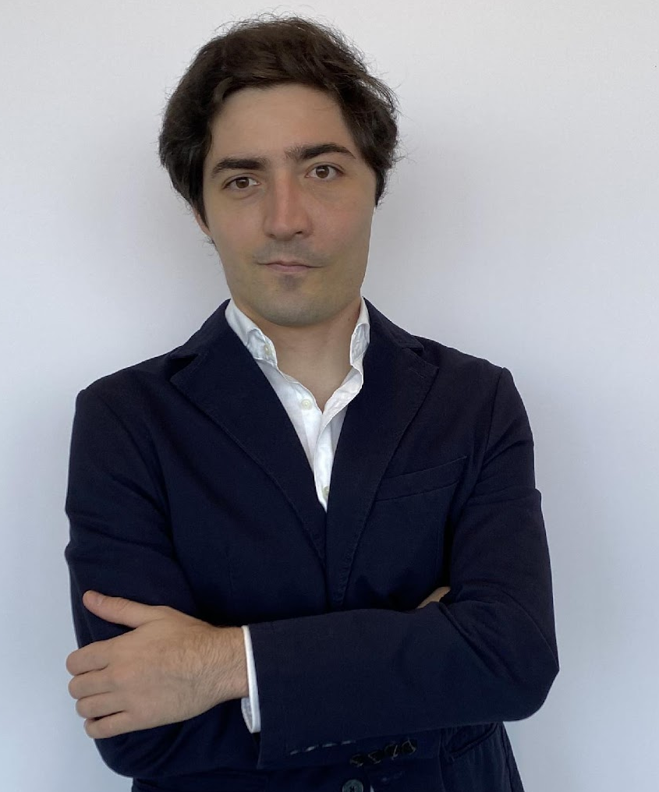



Q&A
Federico Álvarez-Labrador
Denisa Cekrezi
Ben
van Balen
Paola Aybar
Kateryna Rovinska

